Slide 1
Bayesian View of Machine Learning A discussion
KAIM ’18
Anand Krish

Slide 2


Bayesian Perspective
“Grass is always greener on the other side” – The 2 envelope problem
$$E\left[B\right]=E\left[B | A<B\right]p\left(A<B\right)+E\left[B | A>B\right]p(A>B)$$
Belief concentration – Monty Hall problem
1/3
1/3
1/3
2/3
A
B
C
A

Slide 3
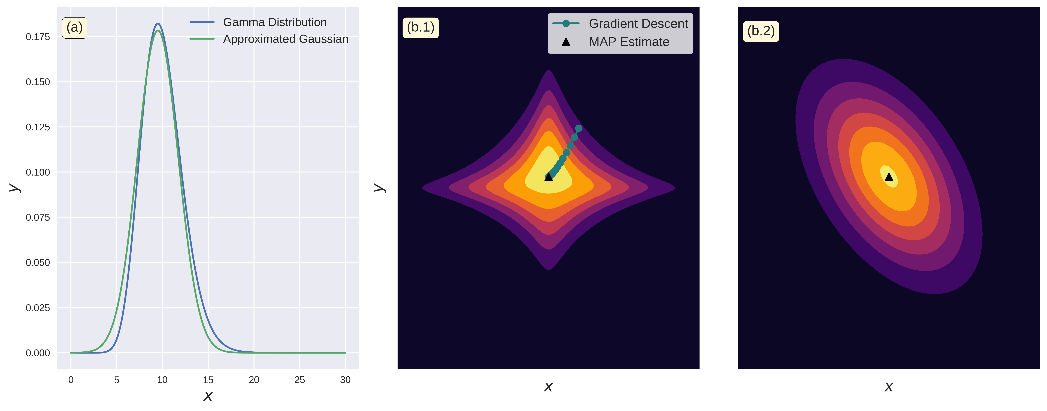
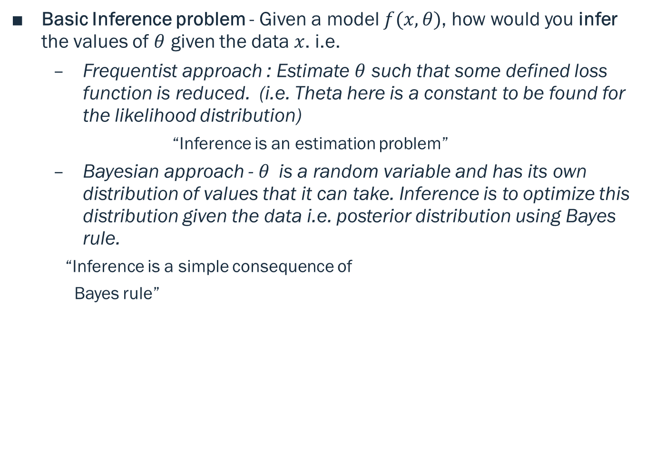
Bayesian Inference
Basic Inference problem - Given a model $f(x, θ)$, how would you infer the values of $θ$ given the data $x$. i.e.
Frequentist approach : Estimate $θ$ such that some defined loss function is reduced. (i.e. Theta here is a constant to be found for the likelihood distribution)
“Inference is an estimation problem”
Bayesian approach - $θ$is a random variable and has its own distribution of values that it can take. Inference is to optimize this distribution given the data i.e. posterior distribution using Bayes rule.
“Inference is a simple consequence of
Bayes rule”

